Slide 1

Superstore Sales Dashboard
Power BI Mini Project by Herman

Slide 2
Project Overview
Sales analysis using Superstore dataset
Built with Power BI (Browser version)
Goal: Generate insights for business decision-making
Published as a portfolio piece

Slide 3
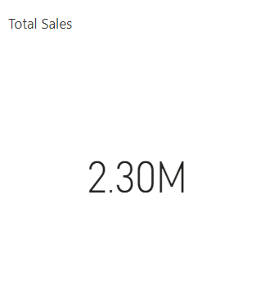
1. Total Sales Performance
Total revenue generated: $2.3 million
Provides a snapshot of overall business activity

Slide 4
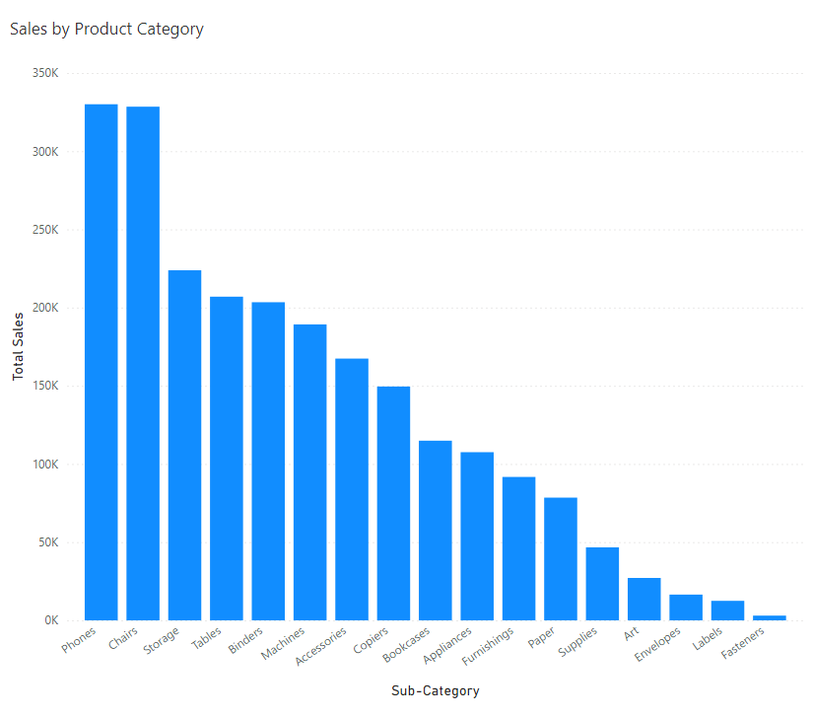
2. Top Product Categories
• Phones: $330,007 (~14.3%)
• Chairs: $328,449 (~14.3%)
• Storage: $223,844 (~9.7%)
• Combined share: ~40% of total revenue

Slide 5
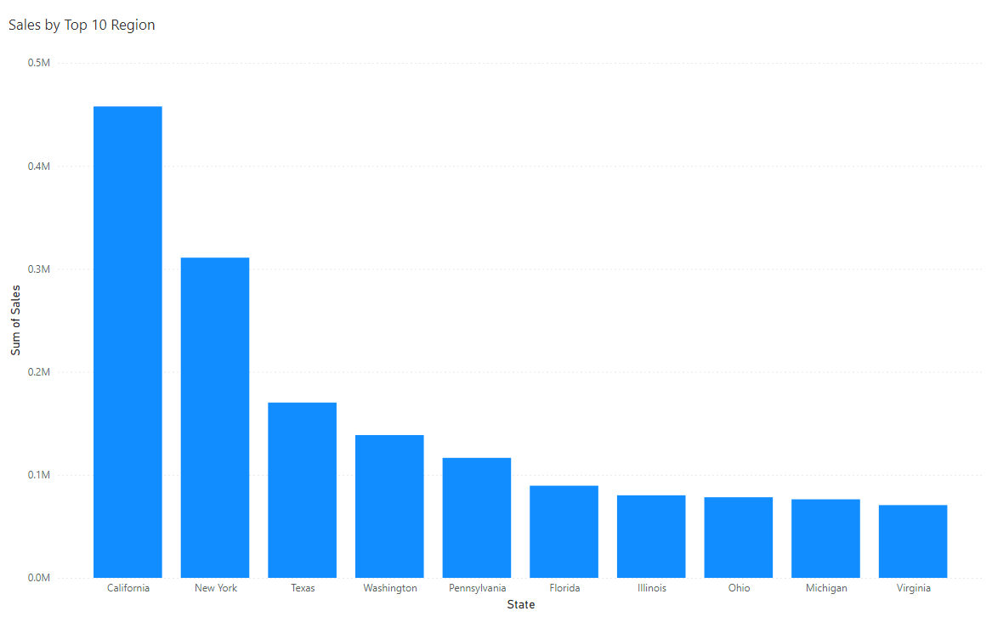
3. Regional Sales Performance
California: $457,684 (19.9%)
New York: $310,877 (13.5%)
Texas, Washington, Pennsylvania complete top 5
Top 5 regions contribute ~52% of total sales

Slide 6
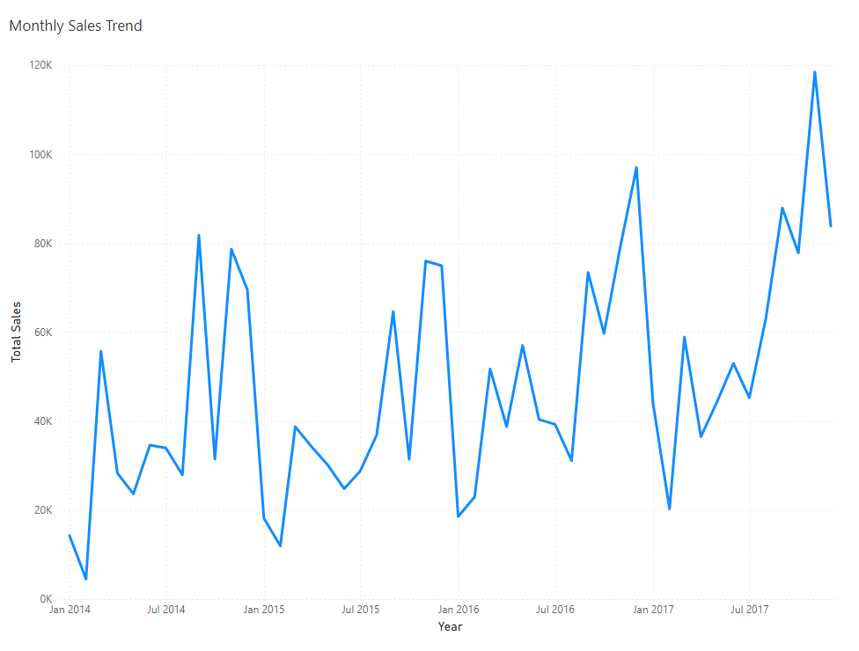
4. Sales Trend Over Time
Peak sales in Nov 2017: $118,448
Lowest sales in Feb 2014: $4,520
Strong seasonal pattern – key for planning

Slide 7
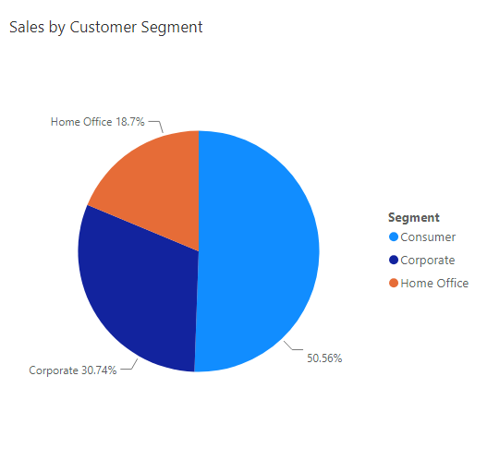
5. Customer Segments
Consumer: $1.16M (51%)
Corporate: $710K (31%)
Home Office: $430K (19%)
Consumer is the dominant segment

Slide 8
Business Recommendations
Promote high-performing products like Phones & Chairs
Focus regional marketing in CA, NY, TX
Align campaigns with seasonal demand (e.g., Nov)
Explore growth in B2B by targeting Corporate clients

